Slide 1
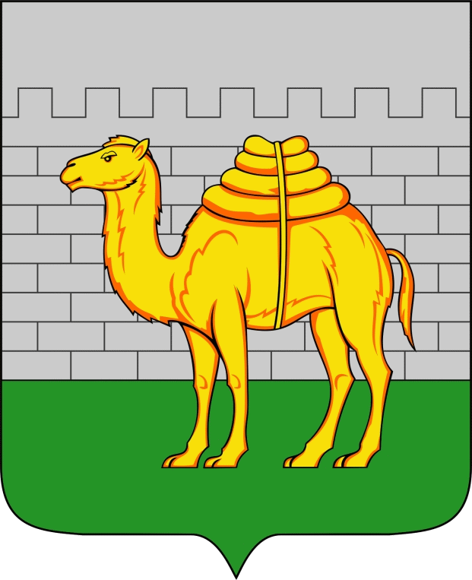
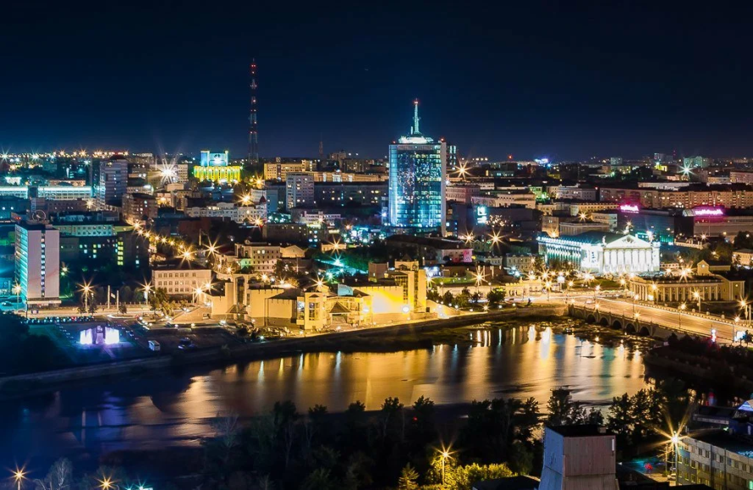
My hometown visitor guide
Chelyabinsk is one of the largest industrial, economic, cultural, and business centers of Russia, the administrative center of Chelyabinsk Oblast. This city is located on the geological border of the Urals and Siberia, in the Asian part of Russia, on the eastern slope of the Ural Mountains, on both banks of the Miass River, about 1,800 km east of Moscow.

Slide 2
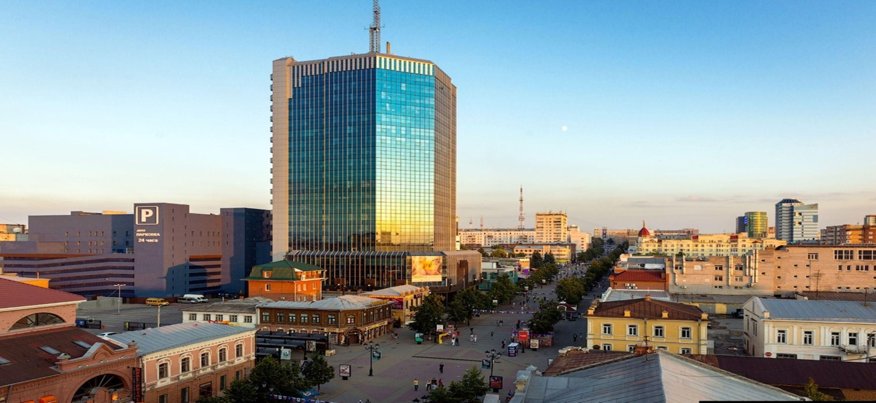
Chelyabinsk travel guide
There are many different architectural monuments in my city.
1) local History Museum 2) Glinka Opera and ballet Theatre 3) Monument To Kurchatov

Slide 3
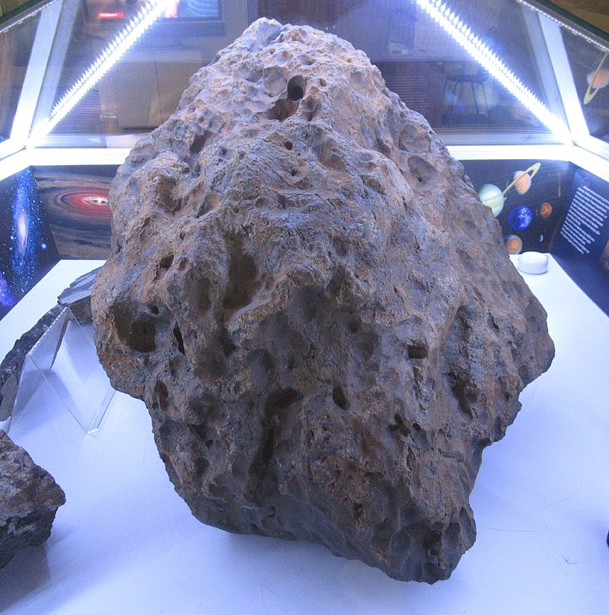
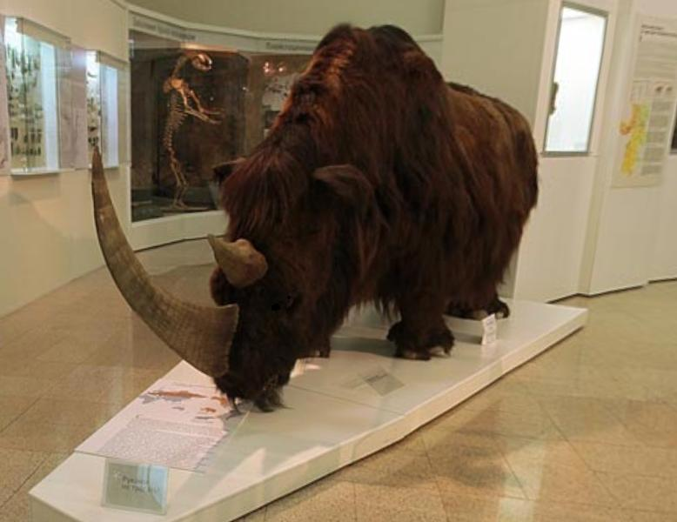
local History Museum
One of the prides of Chelyabinsk in the history of architecture is the Museum of local lore. The Museum houses many different times and peoples exhibits such as the Chelyabinsk meteorite or woolly rhinoceros.

Slide 4
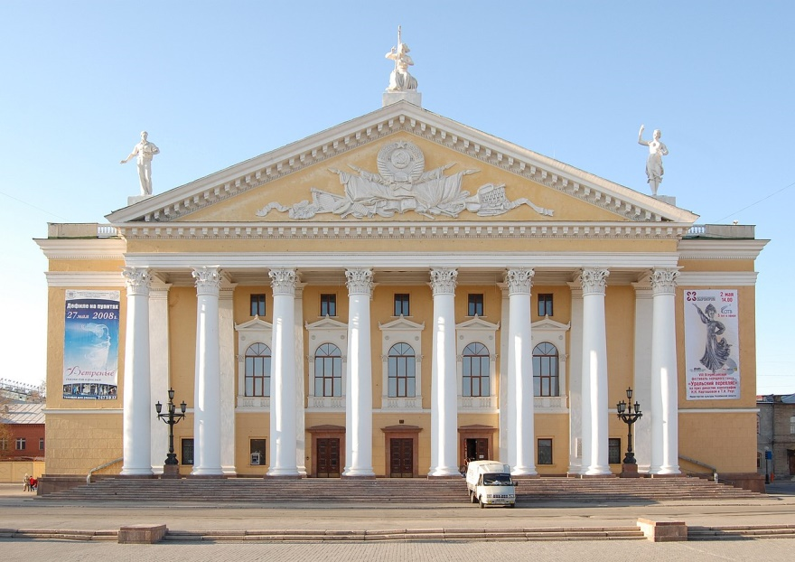
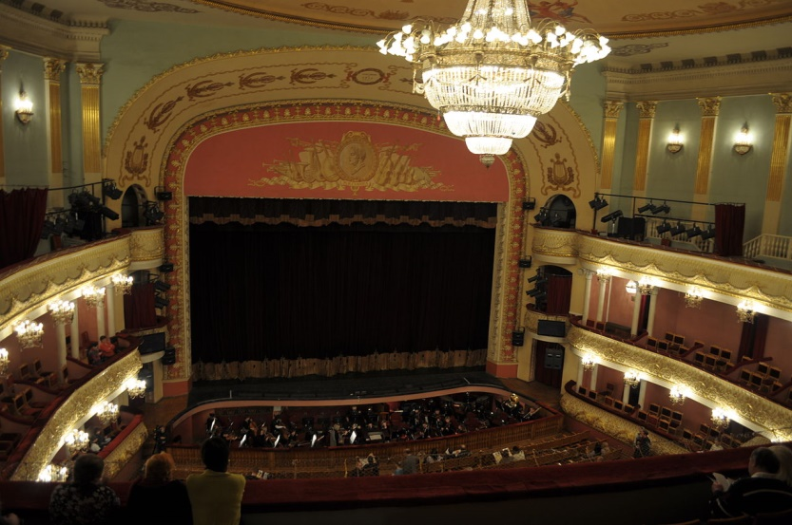
Glinka Opera and ballet Theatre
The Opera and ballet theatre named after Glinka. The theater building is built in a strict and restrained style. The facade of the building is made with a powerful portico of 8 paired columns in front of a round, and behind a rectangular section. Above its attic end are allegorical sculptural groups.

Slide 5
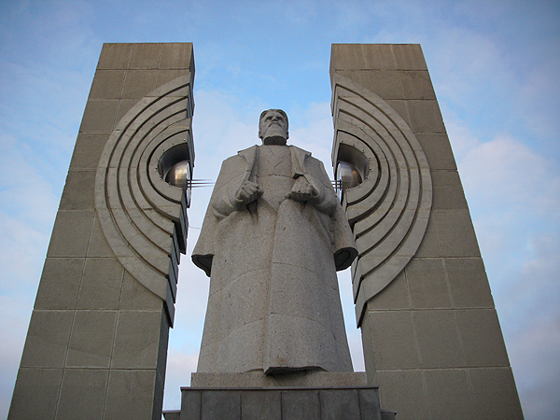
Monument To Kurchatov
One of the founders of chemistry is Igor Kurchatov. He developed the atomic bomb. Under the leadership of Kurchatov, the first RDS-6s hydrogen bomb in the USSR was also developed . For the contribution to the science of our country and the world in our city there is a monument for the work of Kurchatov

Slide 6
Come to Chelyabinsk and learn a lot of new things, see many beautiful architectural monuments, and change your opinion about the city.

